Slide 1


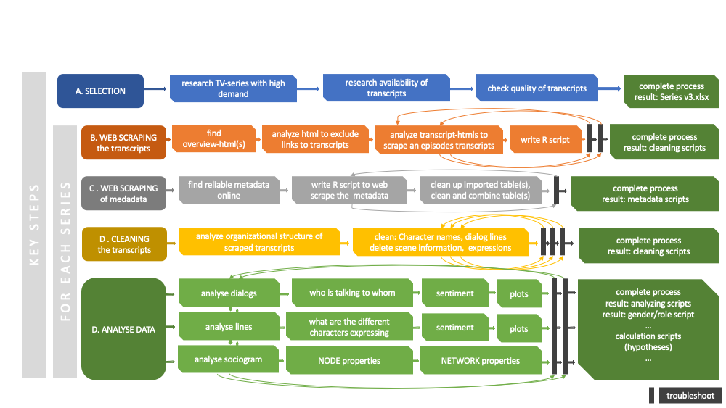

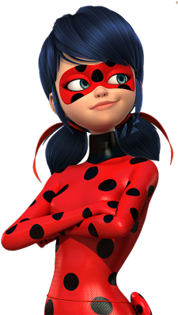




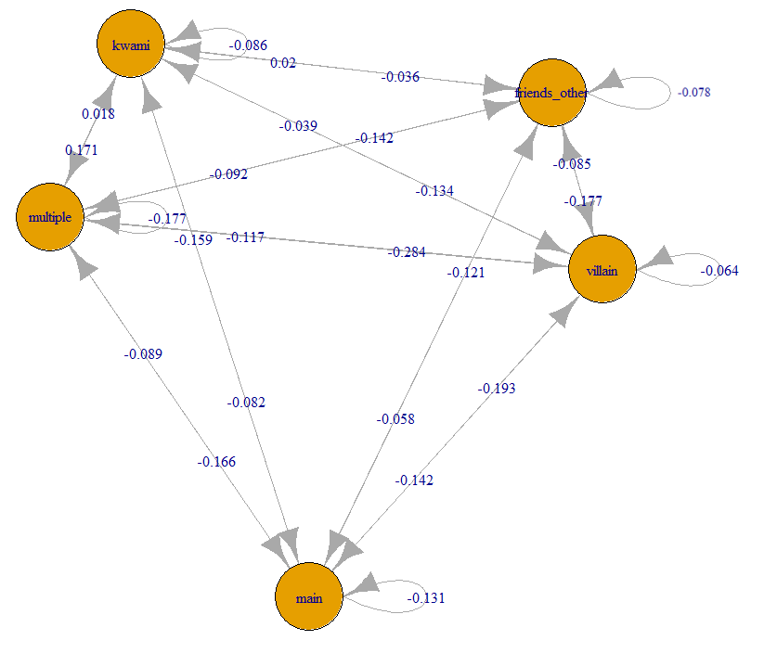
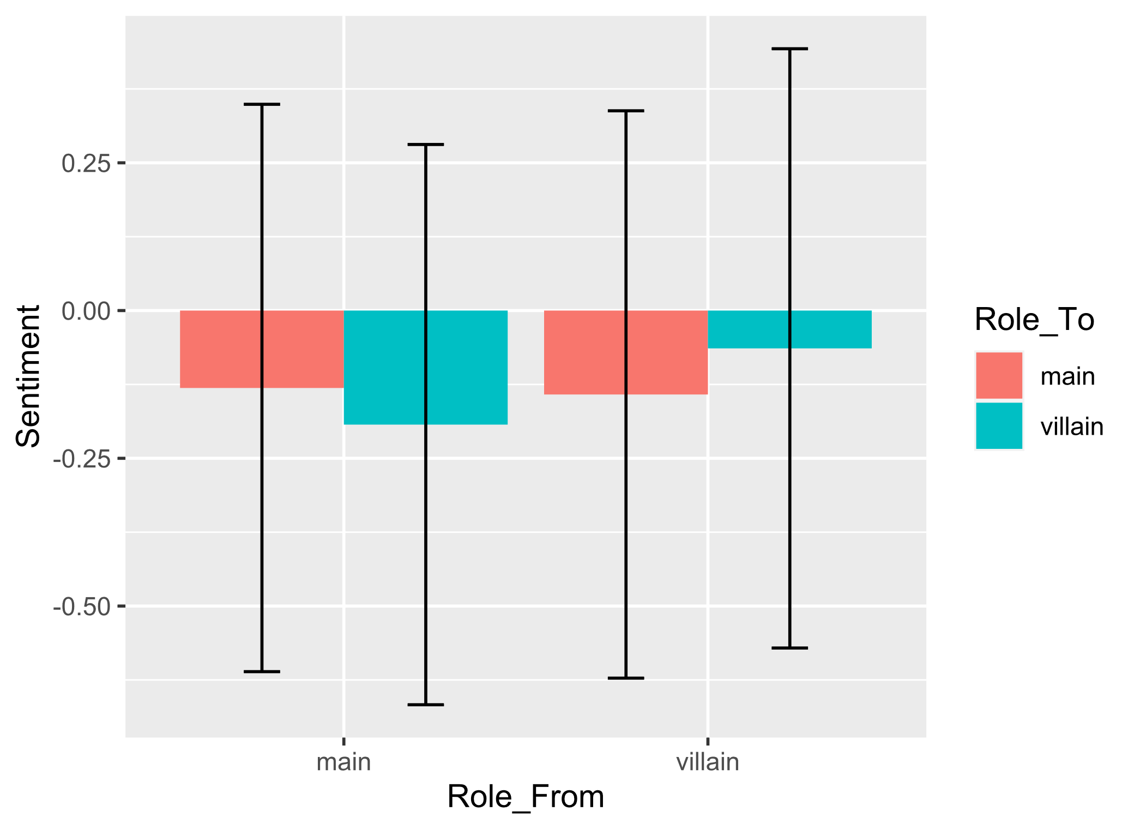


Social structures in children TV series – a network analysis
Laura Gröttrup*, Supervisor: Univ.-Prof. Dr.phil. Guilherme Maia de Oliveira Wood¹
¹University of Graz
Introduction
While in the past the amount of time children could spend watching TV was limited by the number and availability of potential series, nowadays there are hardly any limits, leading to a significant increase of screen time [1]. According to social learning theory, children observe role models in their environment and adopt the behavior practiced [2]. Since models can also be fictional characters like TV characters, the interest in how the characters in these series interact with each other grows, as this behavior is imitated [3].
Due to the large amount of data that series bring with them, the goal of this work was to find a computational method to model the social networks in children's series through the verbalization of the characters. Emphasis is placed on the mapping from sender to receiver and the emotional content of the communication.
The following hypotheses were to be validated:
H1 | Through the network analysis, the social roles can be identified. Specific roles such as main character and villain can be characterized by it.
H2 | Average emotional valence is associated to the thematic role (hero, villain) of each character
H3 | Main characters show the highest range in the valence of emotions between in- and out-degree
Method
The children's series "Miraculous: Tales of Ladybug & Cat Noir" was selected as a proof-of-principle. Using R, the fan-made scripts were fetched from the internet. After cleaning, 131 transcripts of episodes from four seasons containing in total 687 unique speakers (nodes) remained. Metadata such as the assignment of episodes to seasons was also retrieved from Wikipedia using web scrapping and matched with the transcripts.
The communication was defined as always addressing the person speaking next, forming the edges. For the calculation of the sentiment in the verbalizations of the characters the deep-learning R packages sentiment.ai [4] was used, for network analysis, igraph [5].
The five characters with the highest betweenness were chosen as main characters, with one person falling into the villain category, and four main characters.
Figure 1: Research workflow
Table 2: Network properties
Results / Conclusion
Through network analysis, it was possible to map the social structure at the episode, season, and series levels. Table 1 shows the different node characteristics of the characters over the entire series. For the selection of the main characters the betweenness was chosen, meaning how often the person was part of the shortest path. Alternatively, the eigen centrality, which assigns a weight to each edge depending on its influence, could also be used as a criteria for the selection of the main characters.
By means of the sentiment analysis in combination with the network analysis, it was possible to determine both the received and emitted sentiment values per person, per role and in the interaction. Figure 2 shows the interaction with Sentiment between the different roles. It was found that Heroes talk to villains with a significantly more negative sentiment than when villains talk to Heroes (see Table 3).
Takeaway: The method described is applicable for the analysis of social network structures and the interaction between characters and roles in children's series. For a scaling with several series the quality of the transcripts must be ensured.
Attribute
Betweenness | 106480 | 99440 | 55909 | 54010 | 51233
Degree – In | 270 | 238 | 194 | 134 | 148
Degree - Out | 274 | 227 | 195 | 161 | 161
Eigen centrality | 1 | 0.46 | 0.95 | 0.28 | 0.12
Hub score | 1 | 0.46 | 0.9 | 0.28 | 0.1
Authority score | 1 | 0.46 | 0.97 | 0.29 | 0.12
Name | Graph value whole serie | Mean over episodes
Diameter | 19 | 10.5
Edge Density | 0.01 | 0.15
Reciprocity | 0.62 | 0.6
Assortativity | -0.31 | -0.17
Table 1: Node properties for the five characters with the most betweenness
Figure 3: Sentiment villain - hero with standard deviation for Anova
 | DF | Sum Sq | Mean Sq | F value | Eta Square
Role_From | 1 | 4 | 4.447 | 4.590 | 0.0000565
Role_To | 1 | 1 | 1.452 | 1.499 | 0.00203
Role_From:Role_To | 1 | 19 | 19.381 | 20.004 | 0.00327
Residuals | 6106 | 5916 | 0.969
Figure 2: Sociogram between roles with sentiment
Table 3: Results two-way Anova
References:
[1] Chen W., Adler J. (2019). Assessment of Screen Exposure in Young Children, 1997 to 2014. JAMA Pediatr. 2019;173(4):391–393. doi:10.1001/jamapediatrics.2018.5546
[2] Bandura A. (1969). Social-learning theory of identificatory processes. Handbook of socialization theory andresearch, 213, 262
[3] Meltzoff A. N. (1988). Imitation of televised models by infants. Child development, 59(5), 1221–1229. https://doi.org/10.1111/j.1467-8624.1988.tb01491.x,
[4] Csardi G, Nepusz T (2006). The igraph software package for complex network research. InterJournal, Complex Systems, 1695. https://igraph.org.
[5] Wiseman B., Nydick S., Wisner T. (2019). sentiment.ai: Simple Sentiment Analysis Using Deep Learning, https://benwiseman.github.io/sentiment.ai/
*Corresponding author: laura.groettrup@tu-graz.at
Notes:
Table 1 mean per episode - done
Table 2 bild und top 5 betweeness pro episode - done
Anova bedinunen balkendiaramm (f werte, freieitsrade, p-wert, Sum Sq, Mean Sq, eta square) - done
Anova zalen als bild in - done
Rp werte deuten assorziativitaet inzufueen - done
Felerbalken anova balkendiaramm = valence sentiment wert – done
Results / Conclusion
Edge Density sinnvoll ueber ganze Serie, oder besser pro Folge dann mean?
Through the creation of the graphs, it was possible to identify some characteristics of the social structure within the series. Table 1 shows selected properties of the graph over the complete series, Table 3 shows properties that can be calculated per node, in this case concerning the main character Marinette.
Figure 2 shows the sentiment between the roles. Main character are showing significant more stress when talking to villains as villains when they talking to main. Friends and kwami (like sidekicks) speak with a relatively high valence to everybody except to villains, which is expected for there roles.
In Table 3 one can see the general sentiment score of spoken and received messages. Contrary to what was expected in H3, the main characters do not receive more stress and return less negative statements, but the other way around they receive more positive statements.
Takeaway messae: metode anwendbar, quality of raw data very important, verleic andere serie, anwendunsbereic reference scriftsteller,
R packaes referencesn

